Slide 1
New South Wales Dashboard
Confirmed Cases 2020 to 2021

Slide 2
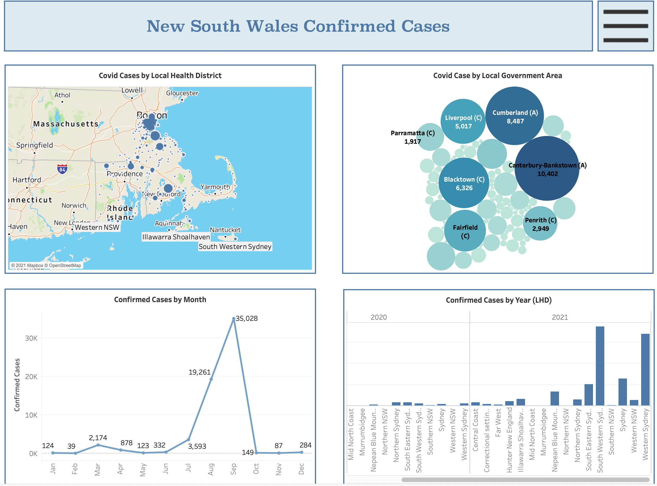
NSW Dashboard
Number of Covid cases by local health district (LHD)
Number of Covid cases by local government area (LGA)
Number of confirmed cases by month
Number of confirmed cases by year (LHD)
Notes:
The dashboard shows the tabular data in visual analytics format. The visual format allows the user and stakeholders to understand the movement of covid cases per area, district, and date. The dashboard is a meaningful reference for strategic meetings and decision-making.

Slide 3

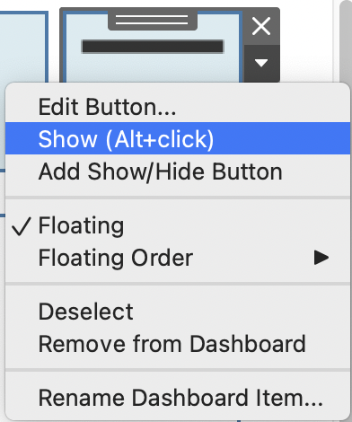
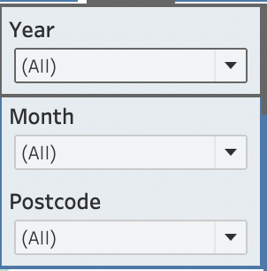
Tableau Navigations
The icon with three lines is a filter the data needed to appear in the dashboard
Click ”Show (Alt+click) to show the filter options
The user can filter data by “Year”, “Month” and “Postcode”
Notes:
The filter drop-down is in default “All” for presentation purposes. The user can choose the year 2021 and November month, to show the number of cases for the current month. The selected options in the filter will change the data in the visual format (graphs, map, chart). Click ”Hide (Alt=click) to hide the filter option.

Slide 4
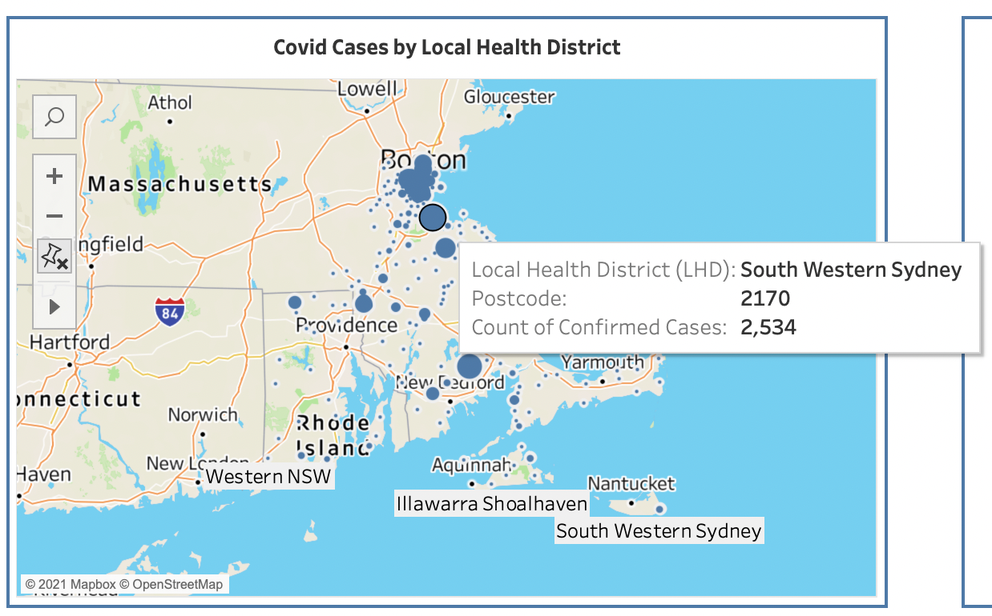
Covid Cases Map
Shows the LHD with the highest number of covid cases
The map helps in visualizing the proximity of areas with the confirmed cases
Notes:
The map shows the areas with the highest number of cases, indicated by the larger dots. The map will help analyze the proximity of each area to help control the spread and apply measures to stop the spread. The map can help in predicting which area will likely most be affected by the increase of cases due to geographical location.
The user can see the LHD name, postcode, and the number of confirmed cases by hovering over the map.
Click the plus “+” and minus “-” sign to zoom in or zoom out the map.

Slide 5
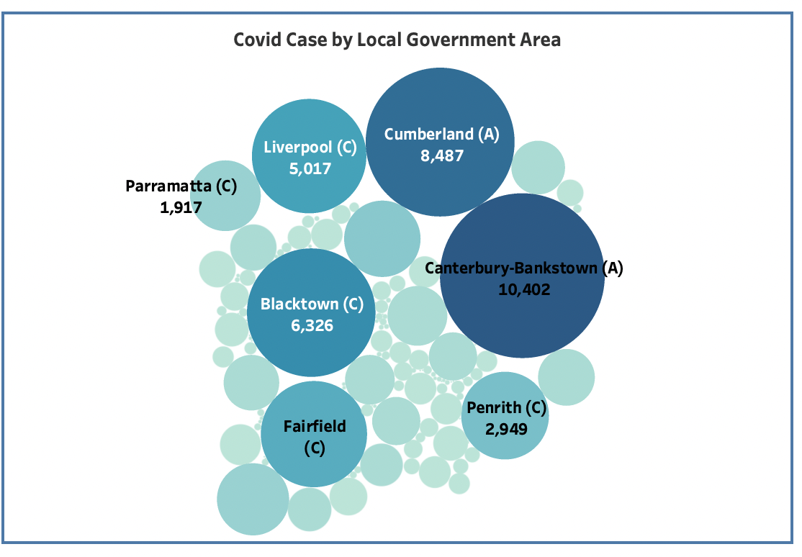
Covid Cases Bubbles Chart
Bubbles chart shows the part of Australia wit the highest number of Covid-19 cases
Notes:
The bubbles chart shows the area in Australia with the highest number of cases. The smaller bubbles are the areas with the lowest number of confirmed cases. The larger bubbles highlight the areas which need an immediate response. The larger the bubbles, the most likely it will pop and needs immediate solutions.

Slide 6
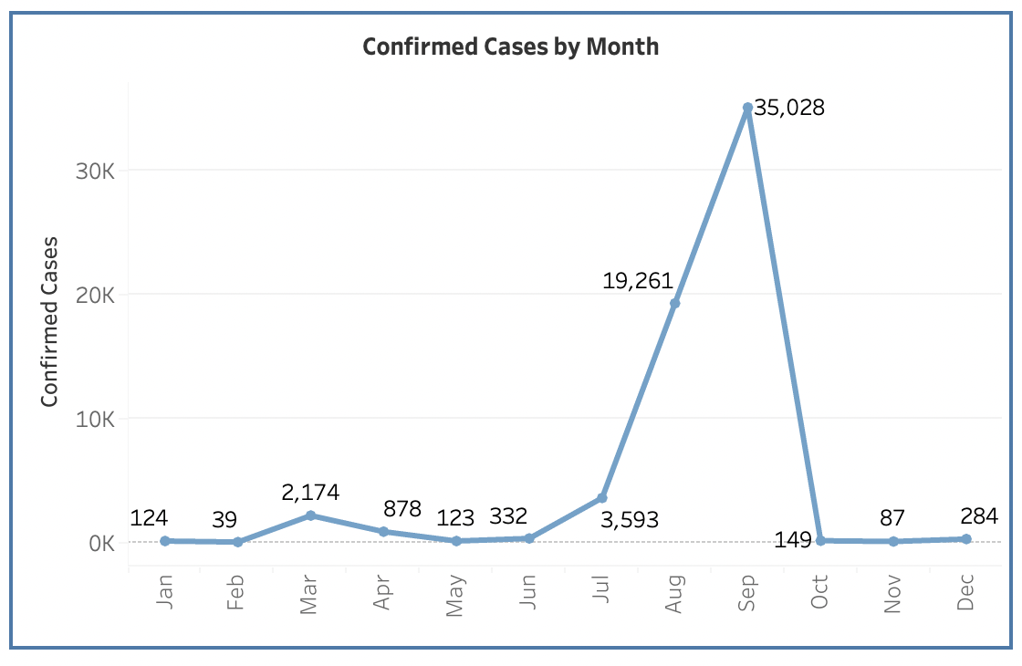
Cases by month Line Graph
Shows the peak of Covid-19 cases by month
Notes:
The line chart will help in analyzing the cause of the peak of confirmed cases in September. What are the events, season, national issues, social activities, and external factors that may affect the shoot up of numbers? This chart will also help in analyzing the effect of vaccination in the control of the spread of the virus.

Slide 7
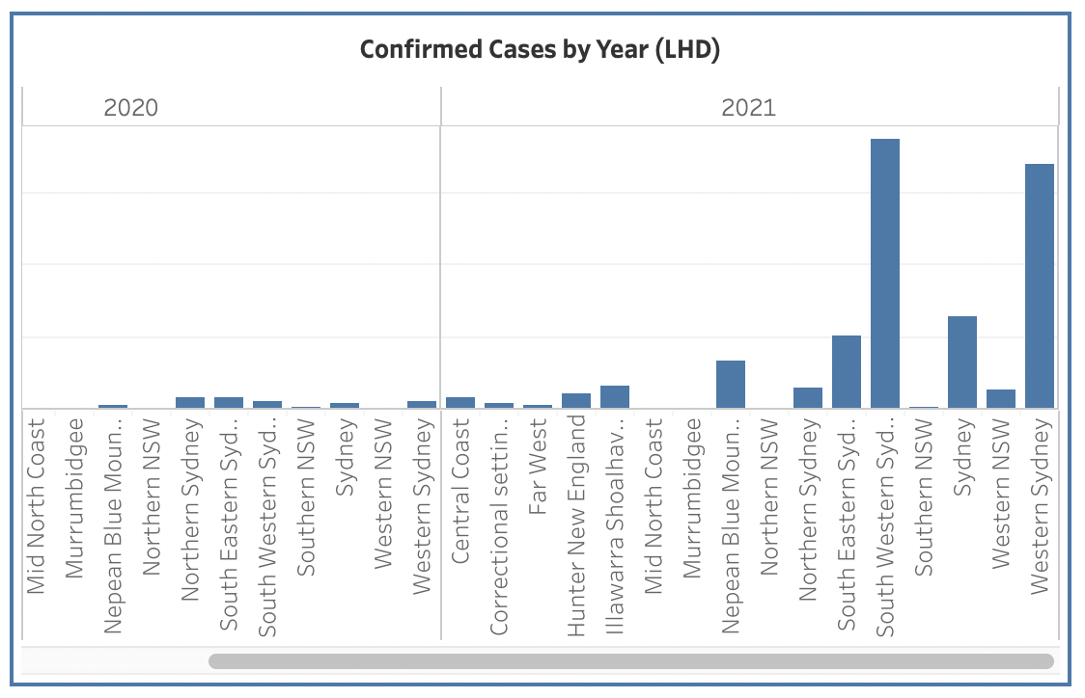
Cases by LHD Bar Graph
Shows the areas with the highest number of cases
Comparison between 2020 and 2021
Notes:
The bar chart will help in analyzing the numbers for the years 2020 and 2021. In this graph, Southern and Western Sydney cases significantly increased in 2021. The graph will help in prioritizing areas and identifying the root cause of the increase. Just by one look, the graph shows that there is an area issue that needs a priority.

Slide 8
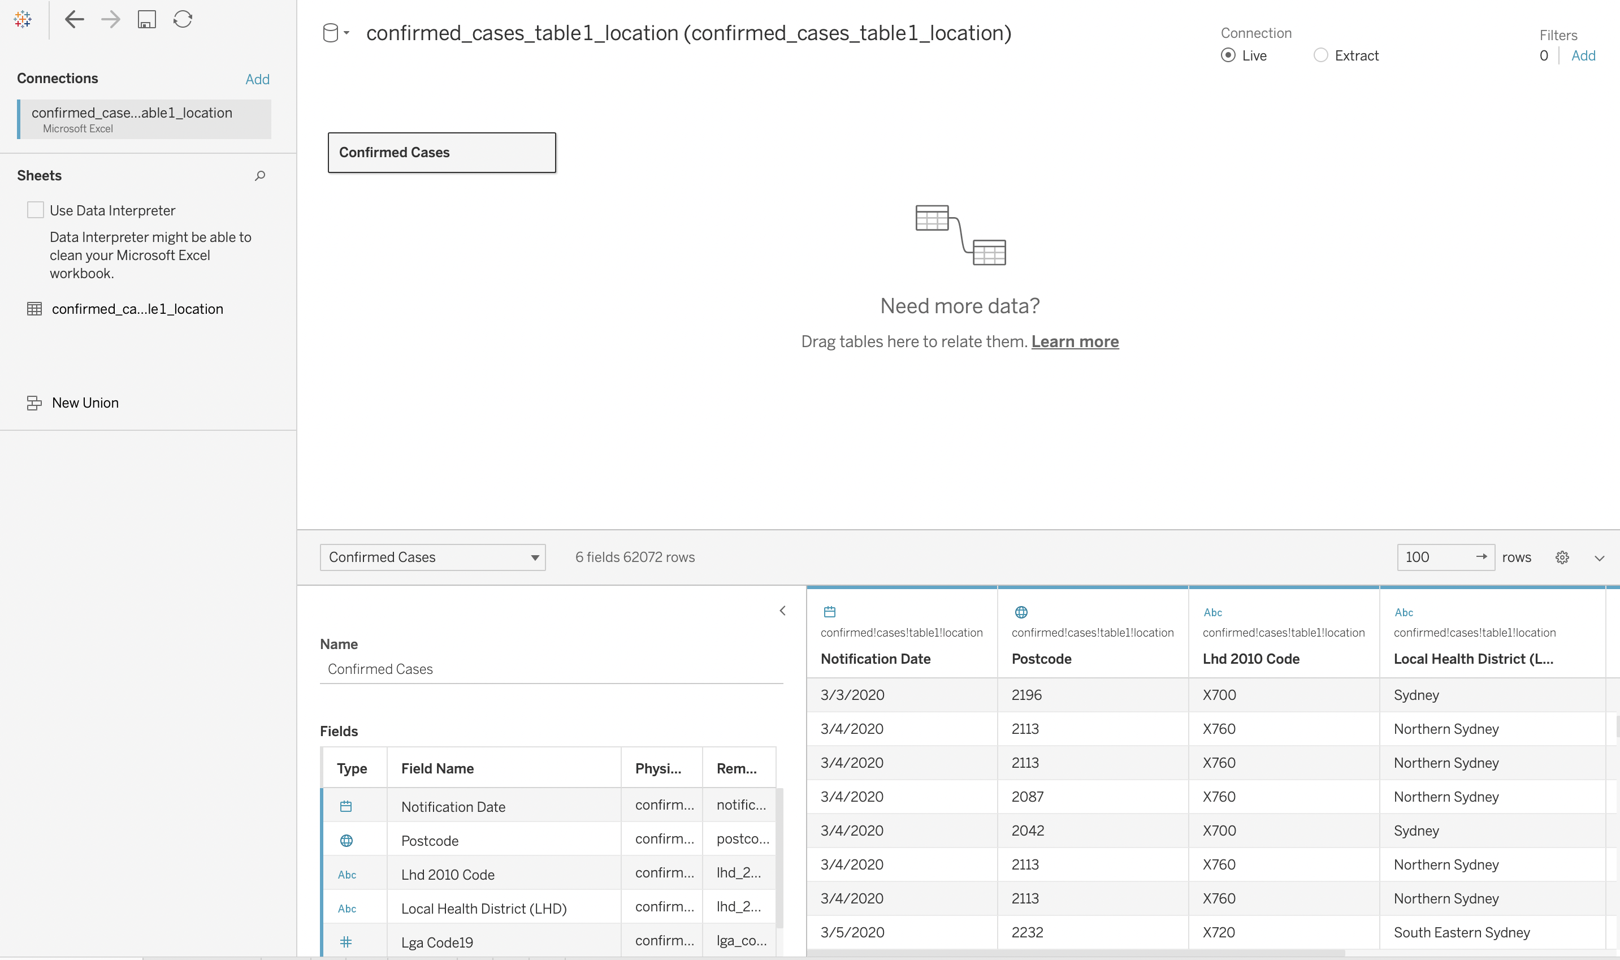
Why visual analytics?
Fast analysis for strategy and decision making
Quick inference
Efficient and time saving (operational efficiency)
Notes:
The data contains more than 62k lines in spreadsheet format which is challenging to understand in layman’s view. A large number of data sets are prone to error if used in their original form. Present the huge set of data in visual forms, which shows the significant area for analysis. Visual analytics will help save time and help in faster analysis for management discussions.

